Slide 1
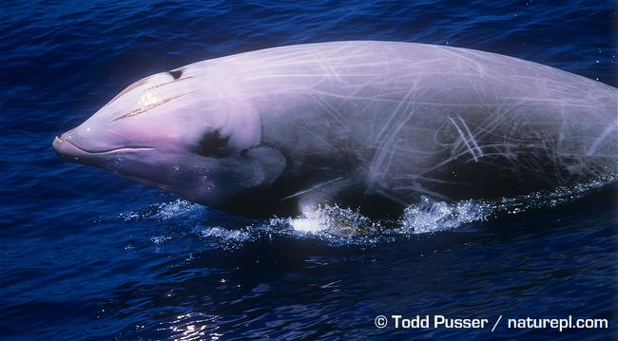
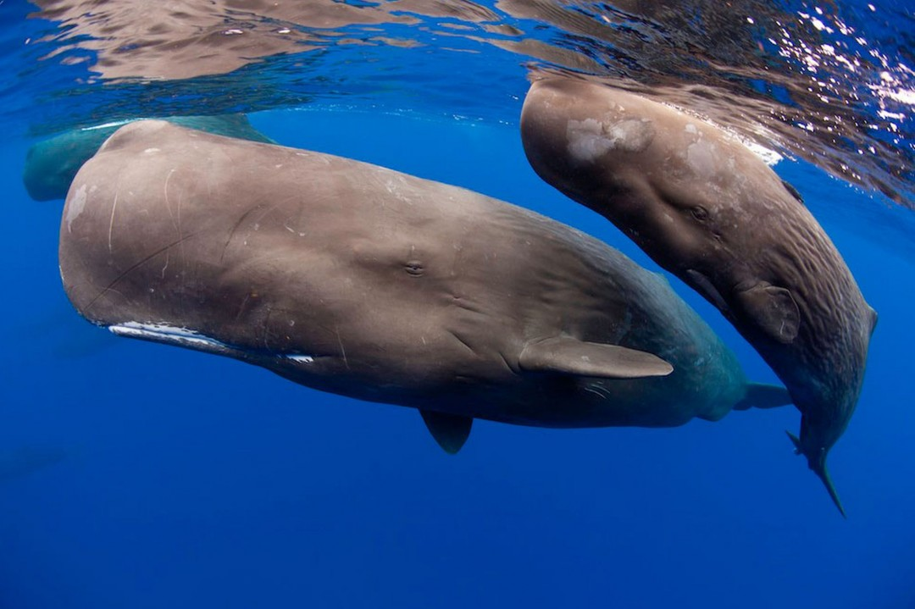
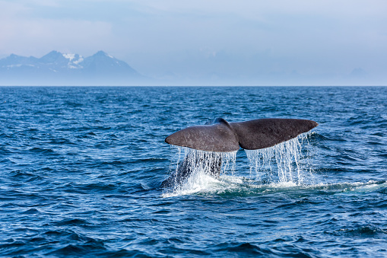
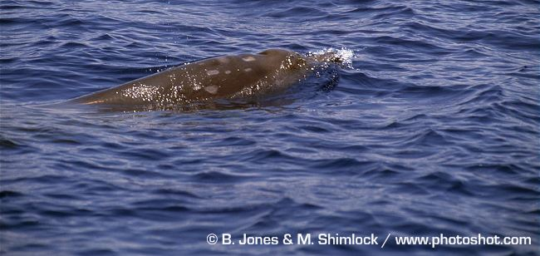


Using passive acoustic data to assess sperm whale population structure in the California Current
Brittany Melton, Tuskegee University
EPP/MSI Scholar Class of 2020
Anne Simonis, Shannon Rankin
NOAA Marine Fisheries Service (NMFS)
Green News
iStock Photo
Notes:
Speaking:
This summer I had the pleasure of interning at the NOAA Marine Fisheries Service line office under my mentors Ms. Anne Simonis and Ms. Shannon Rankin.
* Today I am going to speak about the analyzation of sperm whale populations in the California Current. The populations were analyzed through passive acoustic data.

Slide 2
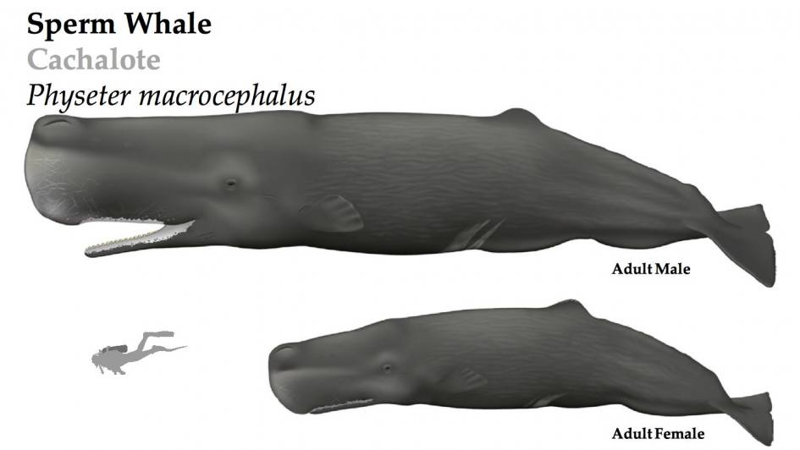
Sperm Whales (Physeter macrocephalus)
Deep Diving Species
Dimorphism:
Males - 14 m
Females - 11 m
Endangered Species
Azores Whale Watching
Notes:
1(Deep Diving Species): Sperm whales are deep diving pelagic species which makes them hard to locate and study; they are widely distributed throughout the world’s oceans. However, the location of focus for this study was the CALIFORNIA CURRENT
- 2 (Dimorphism): On the right is a picture that shows males are longer in length than females.
3 (Endangered Species): Sperm whales are endangered species; this study was important to assist with conserving them by having the knowledge of the population structure.

Slide 3
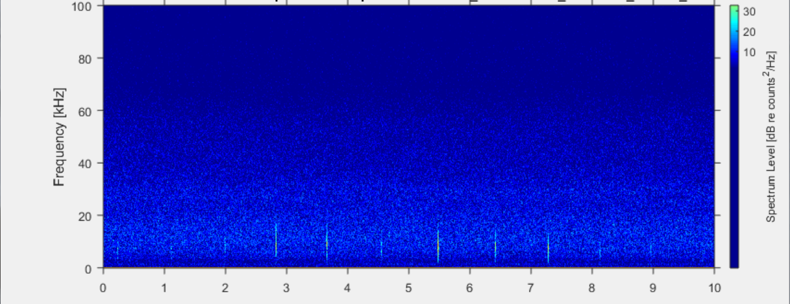
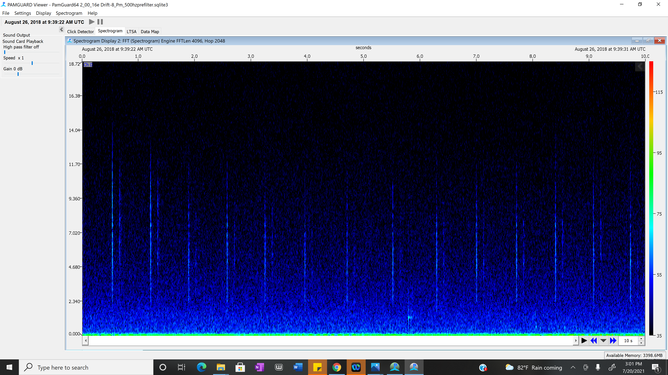

Echolocation Clicks
What are Echolocation Clicks?
Usage of Echolocation Clicks
Foraging
Distinct Click Production
Spectrogram of Echolocation Clicks
Click
Notes:
1 (What are Echolocation Clicks?) :
Echolocation clicks are short acoustic signals that sperm whales release repeatedly most often when they are diving.
2 (Usage of Echolocation Clicks): Light does not travel well through the ocean. This makes it hard for them to see, forage, and navigate. Which is why they rely on echolocation clicks to do these things.
Foraging: sperm whales mainly use their clicks when they are searching for prey. When the whales release these clicks, the sound from it vibrates throughout the ocean until the sound hits their targeted prey and directs itself back to them. This not only allows for the whale to retrieve its prey, but also how to approach that prey by knowing exactly what it is in size, length and species.
3(Spectrogram of Echolocation Clicks): A spectrogram allows us to see a sound. On the right is a spectrogram that displays the sound of a click. On the x axis there is time and on the y axis there is frequency. The LOUDNESS of the sound is shown by the colors. On this spectrogram the blue arrow is pointed to a line that is one click, and you can see that there’s one click per second. Attached is an audio of sperm whale clicks, for you all to hear what the spectrogram is displaying. Please press play on the audio.
4(Distinct Click Production): The clicks sperm whales produce differentiates from the echolocation clicks other odontocete species produce. This is mainly because a sperm whale’s echolocation click is normally within the frequency band of 2-30 kHz and their ICIs usually fall within 0.5 – 2s seconds long.
SR: This is a a picture of the sound and on the x axis is time, y axis is frequency and you can see these clicks (how theres one click per second) *could snap fingers or tap on table*
- Introduce axis and say you see these lines at the bottom, that’s a sperm whale click. (explain in super basic level of the spectrogram)

Slide 4
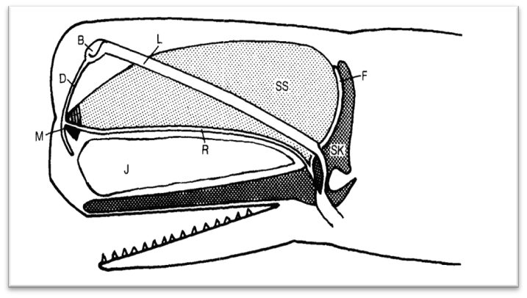
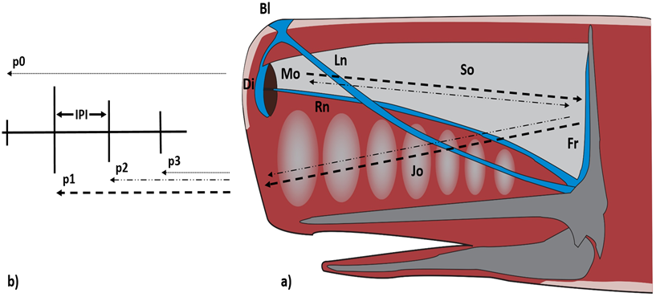
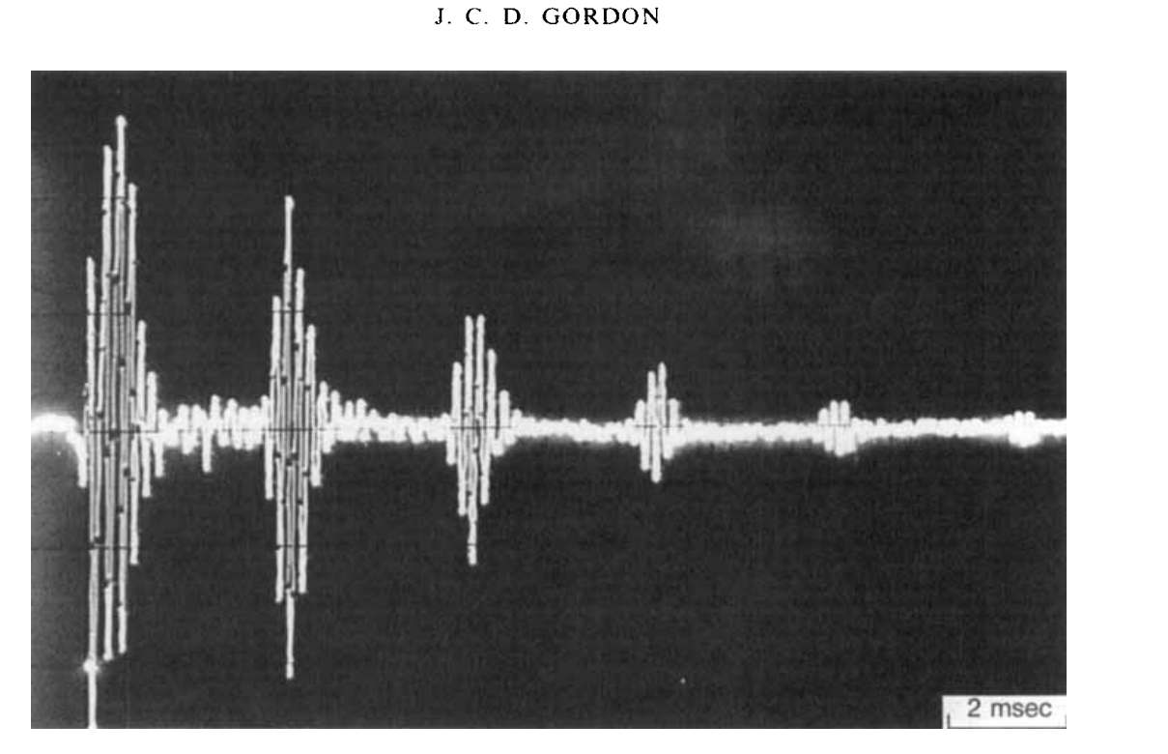
Sperm Whale Head Sound Production
Pulse (1)
Pulse (2)
Caruso et al. (2015)
Notes:
The process of sound production in the sperm whale head was shown on the left picture. The sperm whale produces a sound and then SOME of the sound radiates through the ocean which notes the FIRST PULSE, and the REST goes backwards into their head and exits through the lower forehead radiating through the ocean again which notes the SECOND PULSE. This process repeats itself until the pulse begins to decay and is nonexistent, which is shown in the time series on the right. To summarize, They make a single click and part of it bounces through the whale's head and within that click are shorter acoustic signals called pulses which is also shown in the time series on the right. The distance between the pulses is related to the size of the sperm whale's head.
To understand how echolocation clicks are produced and how they successfully spread throughout the ocean you have to understand the sperm whale head anatomy first. On the left Is a depiction of a sperm whale head with the anatomical structures highlighted that help produce the acoustic sounds that are known as clicks and within those clicks are pulses. A pulse is an even shorter acoustic signal that is located between clicks. It is measured in milliseconds (ms).
THE PROCESS OF SOUND PRODUCTION IN THE SPERM WHALE HEAD: The process of sound production in the sperm whale head is highlighted by 5 numbered anatomical structures. These are (1) the monkey lips (2) the Spermataci organ (3) the skull (4) the frontal sac and (5) the Junk Organ. The whales produce a sound from their monkey lips, which allows for SOME of the sound to pass through into the ocean forming the first pulse from the first click the whale made. the REST of the sound then goes backwards through their distal sac (D) forehead into the spermataci organ (SO) to hit their skull and reflect off the frontal sac (F). The sound makes a u turn and heads out through the junk organ (JO) until it exits through the lower distal sac (D) forehead. The sound then goes through the ocean AGAIN to form the 2nd pulse. (3) Lastly, some of the sound repeats the entire process repeatedly until the sound eventually decays. On the bottom right is a time series of a single sperm whale click with the blue arrows showing the 1st and 2nd pulses. As you can see, the pulses decay and decay until they are nonexistent .
SR: Simple presentation would be if I showed a blob of the sound that their making and if I show the sound moving and part of the sound moves to the head and part of it bounces back. If I can show that as an animation then I wouldn’t have to use many words and I could explain to the aaudience what is going on there and why this click and IPI is helpful (bc when they see that back and forth they would be able to get the longer that distance is back and forth for that echo, the more time in b/w those pulses. (People will get that if they make one click and another click that’s the ICI , but that echo in b/w is the IPI).
- Don’t worry so much about the body parts bc their indirectly related. Stick to acoustics side a little more. – AUDIENCE: They make this click and part of it bounces around in their head.

Slide 5
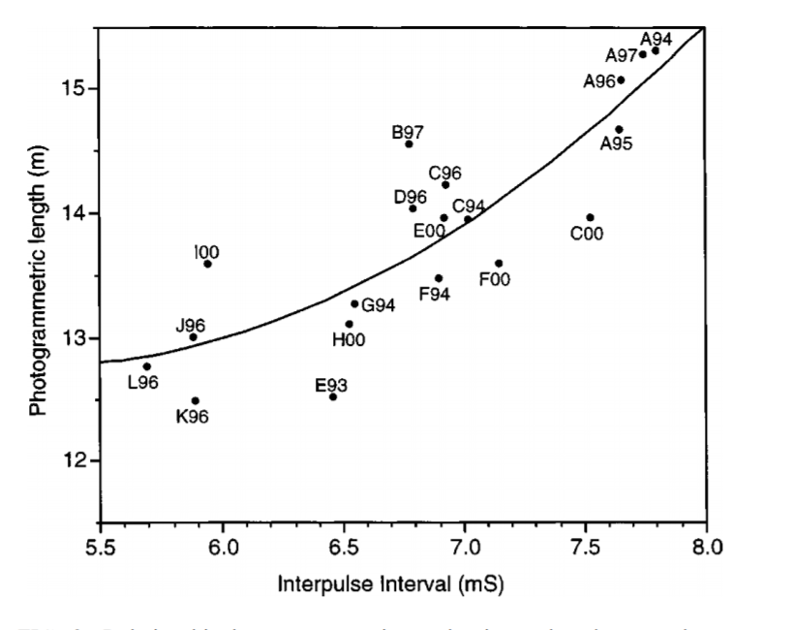
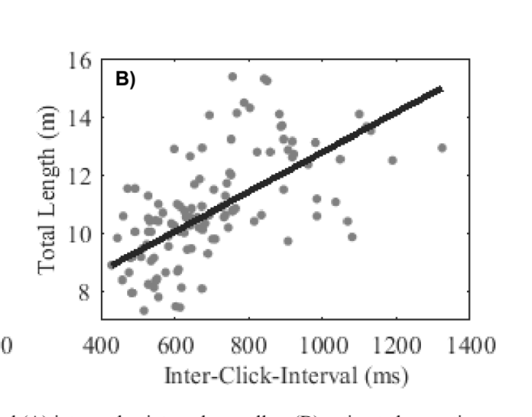
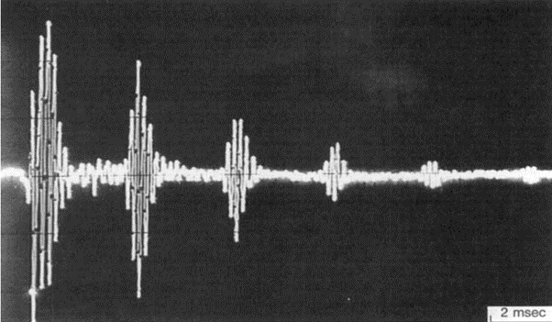




Inter-Pulse Interval vs Body Length
What is an IPI?
IPI vs Body Length
Rhinelander et al. (2004)
Gordon et al. (1991)
Notes:
1(What is an IPI?): The inter-pulse interval is defined as the time b/w pulses, meaning they are located b/w the pulses. The 1st and 2nd IPIs are pointed out by white brackets in the time series on the left. The IPI is significant because there is a direct relationship between it and body length.
1(IPI vs Body Length Relationship): The IPI to Body Length relationship has been discovered by some researchers. On the right is a visual representation of a scatterplot from a researcher's study with an x axis of the Inter-pulse interval measured in milliseconds and a y axis of the photogrammetric length measured in meters. The IPI to body length relationship is shown by what is called a regression line. To summarize, If we are given an IPI value from a sperm whale we could plot it to find that whales body length.

Slide 6
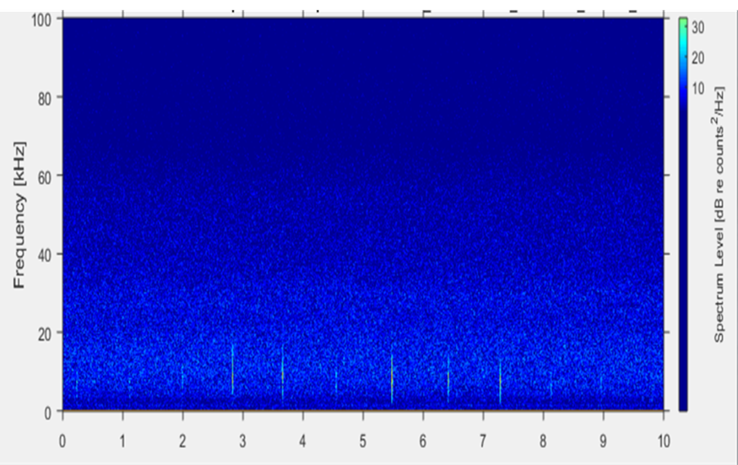


Inter-Click Interval vs Body Length
What is an ICI?
ICI vs IPI
ICI vs Body Length
Calculated ICI from Acoustic Encounters
Notes:
1 (ICI):
The Inter-click interval is defined as the time b/w clicks, as they are located between each individual click the sperm whale makes.
On the right is a spectrogram shown in a previous slide that points out an ICI.
* 2(ICI and IPI relationship):
We don’t know why the ICI and IPI have a relationship, but there is a consistent one there. From this relationship the ICI is easier to measure the body length than the IPI. Therefore, we use ICI to estimate body length.
*3(The ICI vs Body Length Relationship): The ICI to body length relationship is not direct, so it is based off a regression calculation. It has been explored in the Gulf of Mexico and Gulf of Alaska, but with this research, we are the first to explore the ICI to body length relationship in the California Current.
4(Calculated ICI from Sperm Whale Acoustic Encounters): As the passive acoustic data for this study was analyzed, it was easier to calculate the ICI from the sperm whale acoustic events rather than the IPI. Calculating the IPI would be a more complicated process.
ICI – each actual click, IPI – echo kind of.
There’s not a real reason as to why the ICI and IPI are related theres just a tight relationship there. (We know that the IPI and Length are related because of the bouncing in the head but the ICI and IPI are also related, it just happens that the ICI is so much more easy to measure than the IPI. > so, if we can understand these relationships & they are true then we can just measure the ICI.
Reason we want to look at ICI and get this relationship is bc this is tedious this is easy but theres a relationship we could take advantage of there.
EARLY ON: point out IPI vs ICI relationship (add a little more explanation in beginning).

Slide 7
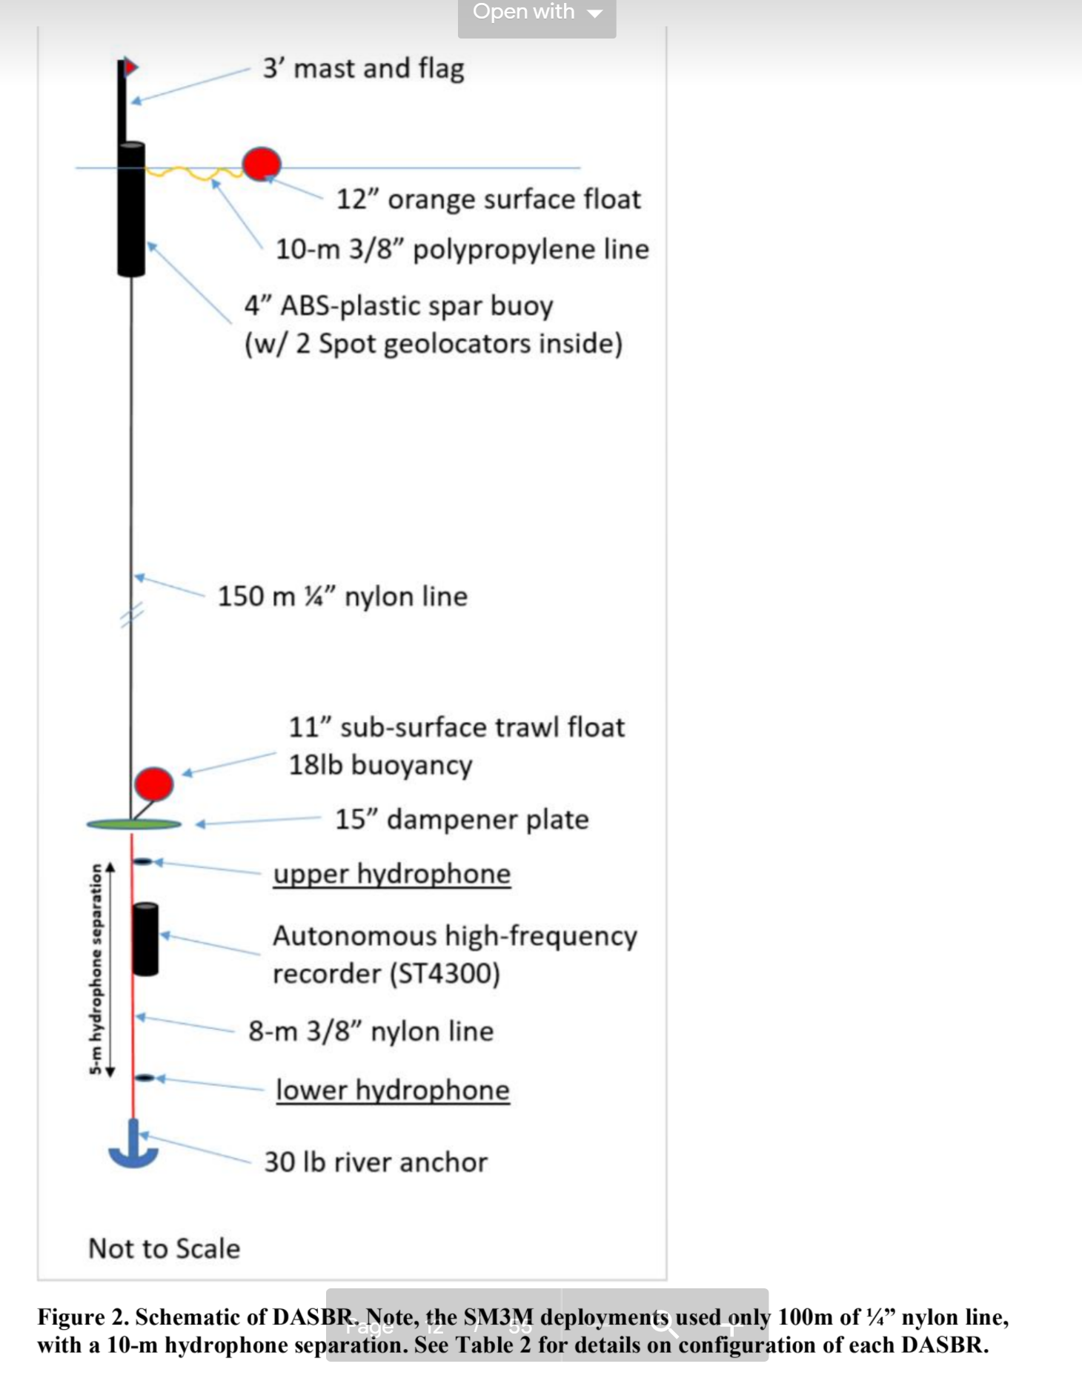
Acoustic Data Collection
Drifting Acoustic Spar Buoy Recorders (DASBRS)
California Current Ecosystem Survey (CCES)
(June – December 2018)
Notes:
1(DASBRS): On the left is a schematic representation of a Drifting Acoustic Spar Buoy Recorders which is also known as DASBRS. The DASBRS collected acoustic recordings of sperm whales while being deployed at different locations in the California Current during the NOAA 2018 California Current Ecosystem Survey (CCES). Although this acoustic data was collected in 2018, for this study the acoustic recordings had to be analyzed again by going through the clicks and pulses from each event to make sure they were viable for this study.

Slide 8
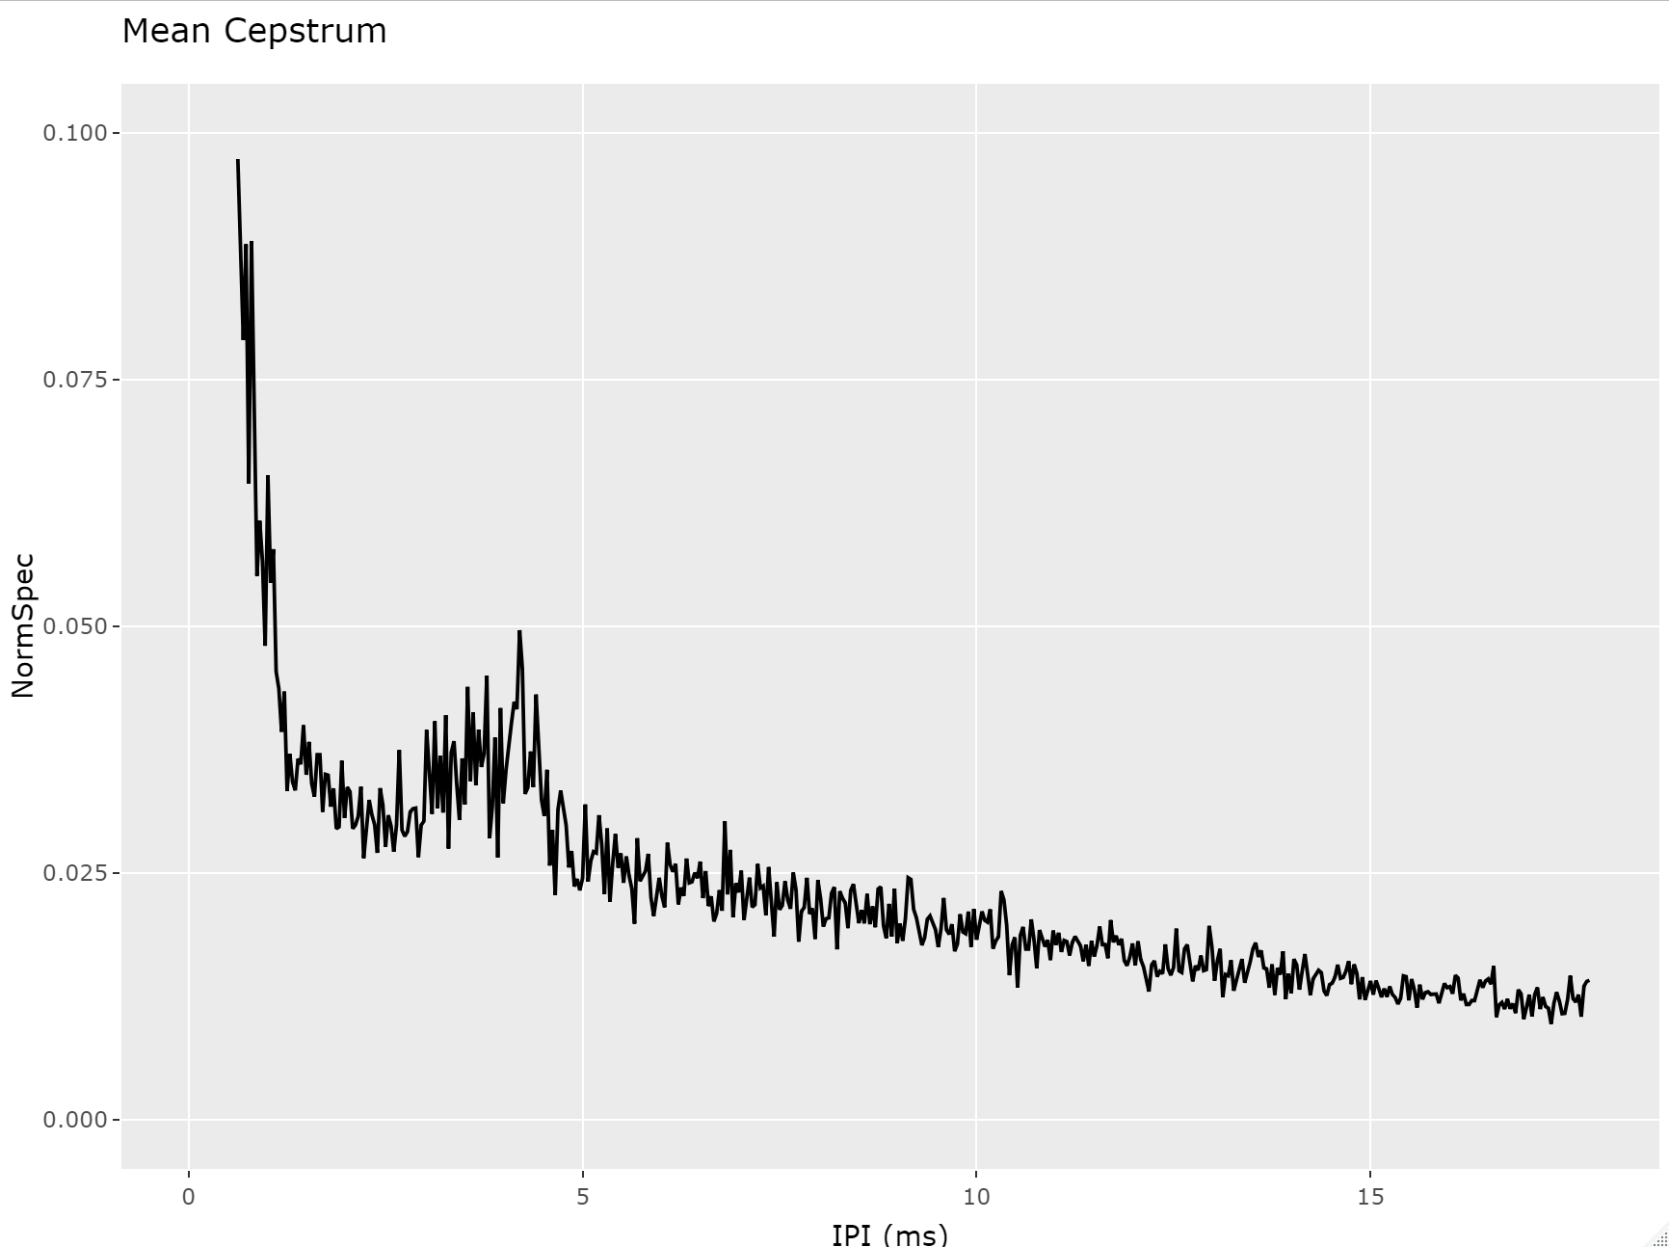
Calculation of Inter-Pulse Interval
IPI Tedious Analyzation
Notes:
1(Calculation of IPI): From the 2018 survey we used drifts 07, 08, and 18 for analyzation. Each drift had events of sperm whale classes which the IPI was calculated from.
(IPI Tedious Analyzation): On the right is a plot with an x axis of the IPI measured in milliseconds and a y axis of the Normal Spectrum. Some calculations were applied to find repeated click patterns to plot these calculations in order to find peaks that represented the IPI value. The issue with this was that most of the time it was hard to identify an accurate IPI value solely based off the repeated click patterns.
we used the cepstrum of the signal to look for these repeated structures which are the pulses. The timing of the IPIs then show up as bumps in the cepstrum. The issue with this was that most of the time it was hard to identify an accurate IPI value based off bumps in the cepstrum.
I am use some fancy math which is good at finding repeated click patterns and plot this fancey math to find peaks which represent the IPI

Slide 9
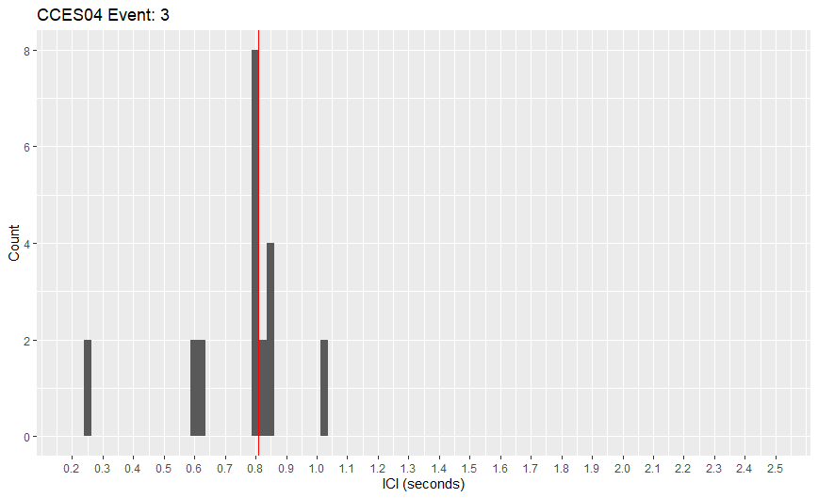
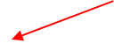
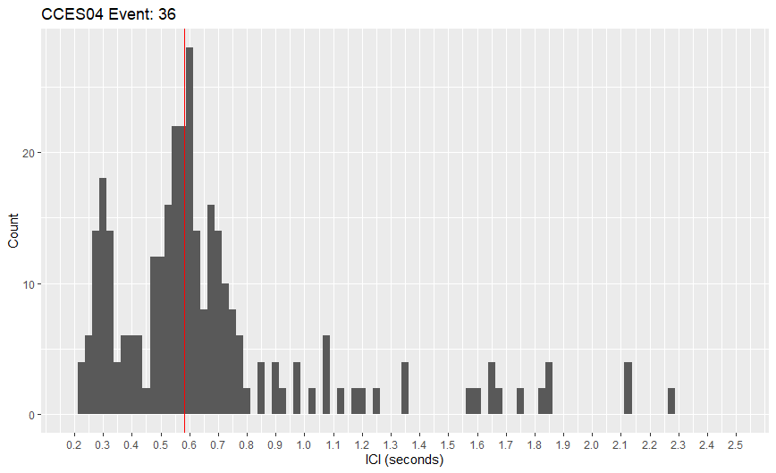
Calculation of Inter-Click Interval
Simple Acoustic Event
Complicated Acoustic Event
Notes:
1(Calculation of ICI): The mode of the ICI for each event from drifts 07, 08 and 18 were calculated using the PAMpal R software package. R code was then formed to view the ICI values in the events to manually compare the highest ICI value to the ICI mode value.
(Simple vs Complicated Acoustic Events): Simple and complicated events were generated and compared. Simple events could be analyzed because they showed a distinct high ICI value that was close to the ICI mode value. On the left is an example of a simple acoustic event that points out the ICI mode with the red arrow. Complicated events had different peaks in different groups within one event. So, the ICI value was identified from only one of those peaks, but there were multiple peaks which suggested there might be multiple whales. This made it hard for us to compare multiple peaks of ICI values to one ICI mode. On the right is an example of a complicated acoustic event that points out the ICI mode with the red arrow. For further data analysis, only simple events were used.

Slide 10
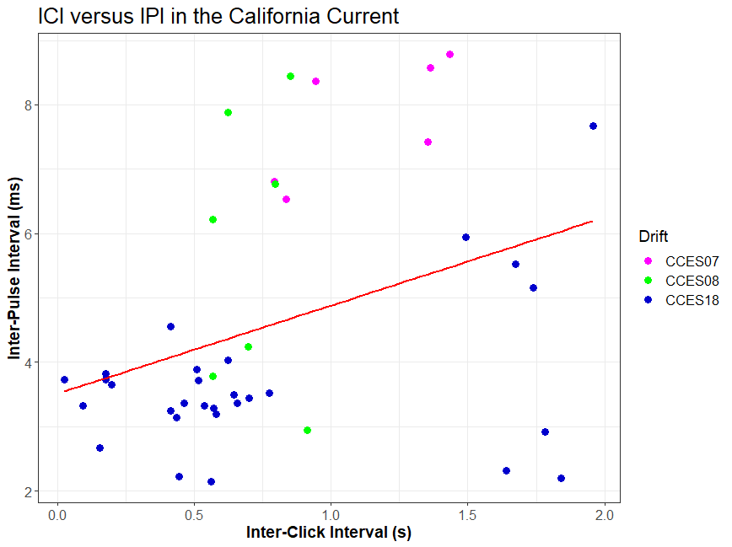
Inter-Pulse Interval vs Inter-Click Interval in the California Current
Notes:
RESULTS : the ICI and IPI are connected by the ICI vs Acoustic Length relationship. The IPI directly shares a direct relationship with the body length. Since the ICI and IPI are connected, the ICI can also be used to tell the body length as the IPI can. On the right is a plot of the IPI vs to the ICI in the California current. We have a x axis of the Inter-click interval measured in seconds and a y axis of the inter-pulse interval measured in milliseconds. There is also a drift legend differentiating drifts 07 (Pink), 08 (green), and 18 (blue). Our goal was to show the relation between the IPI and ICI from the drifts used, this relationship is depicted by the solid red line stroked throughout the plot.
This relationship was applied by taking the ICI value from other drifts not used in our data analyzation and plotting it to find an accurate value of the IPI.

Slide 11
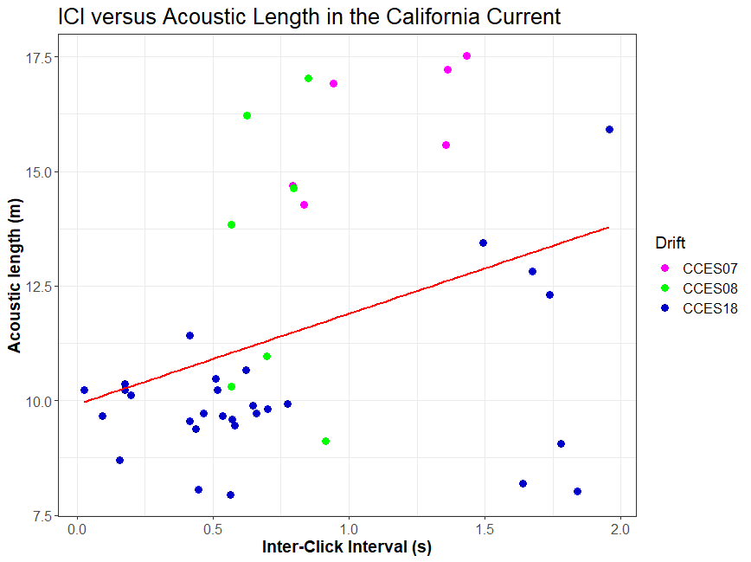
Inter-Click Interval vs Acoustic Length in the California Current
Regression Calculation: Acoustic Length = 1.98 * ICI + 9.92
Notes:
RESULTS: The ICI vs Acoustic Length relationship is not direct, so it is based on the regression calculation shown on this slide. On the right is a plot of the ICI to Acoustic Length in the California Current. We have a x axis of the inter-click interval measured in seconds and a y axis of the Acoustic length measured in meters. There is also a drift legend differentiating drifts 07 (Pink), 08 (green), and 18 (blue). Our goal was to show the relation between the ICI and the Acoustic length from the drifts used, this relationship is depicted by the solid red line stroked throughout the plot.
To summarize, If we took the value of an ICI from a sperm whale in another drift not used in our data analyzation, we could plot it to find an accurate value of the acoustic length.

Slide 12
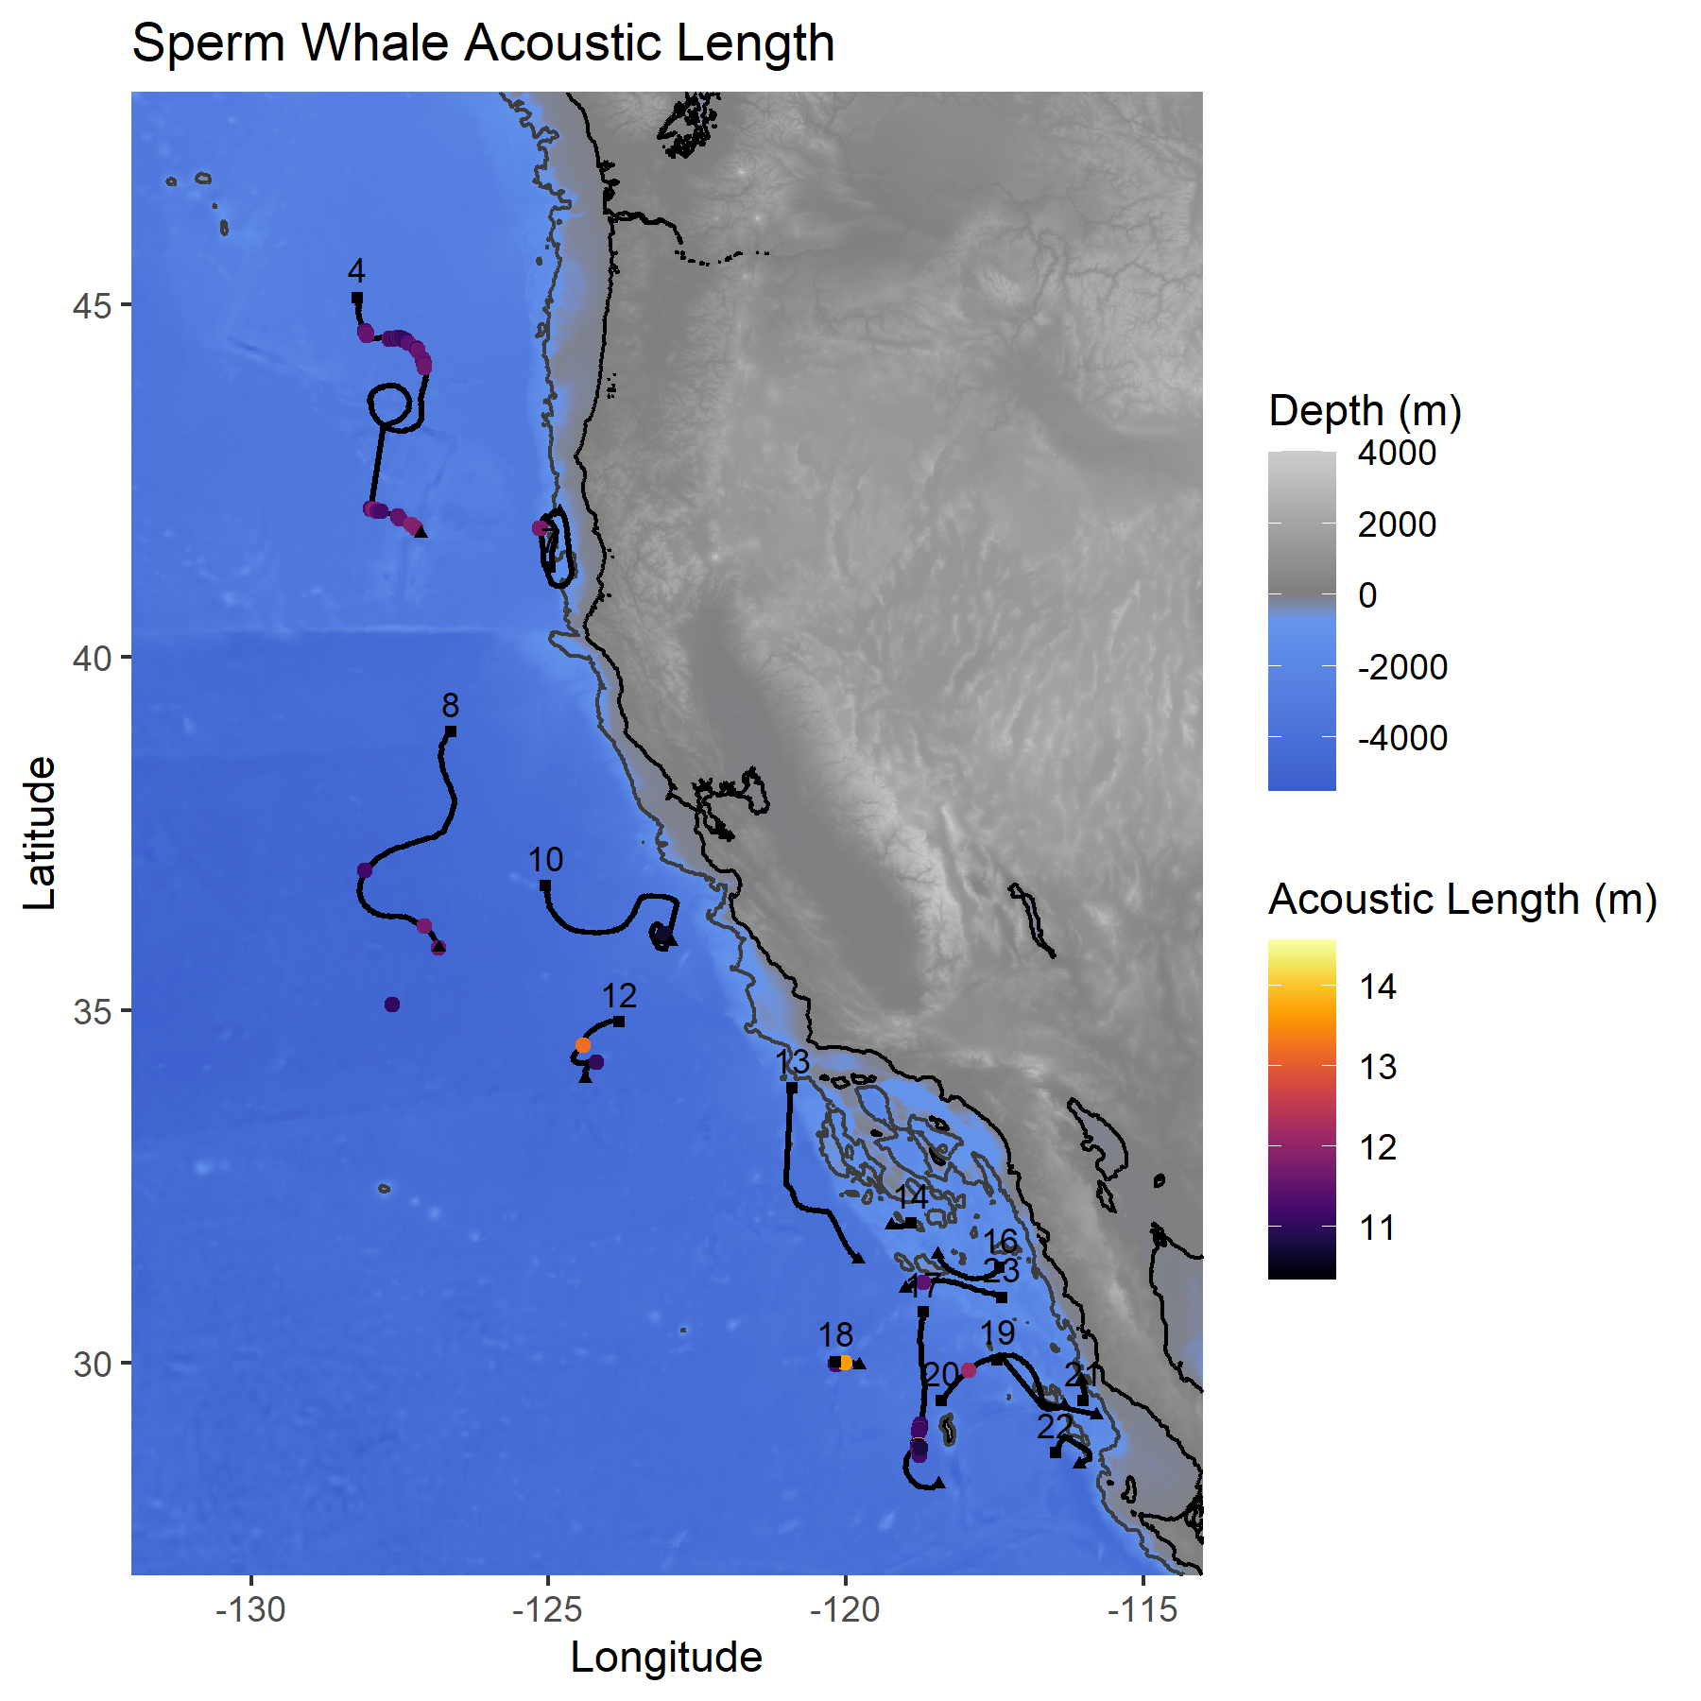
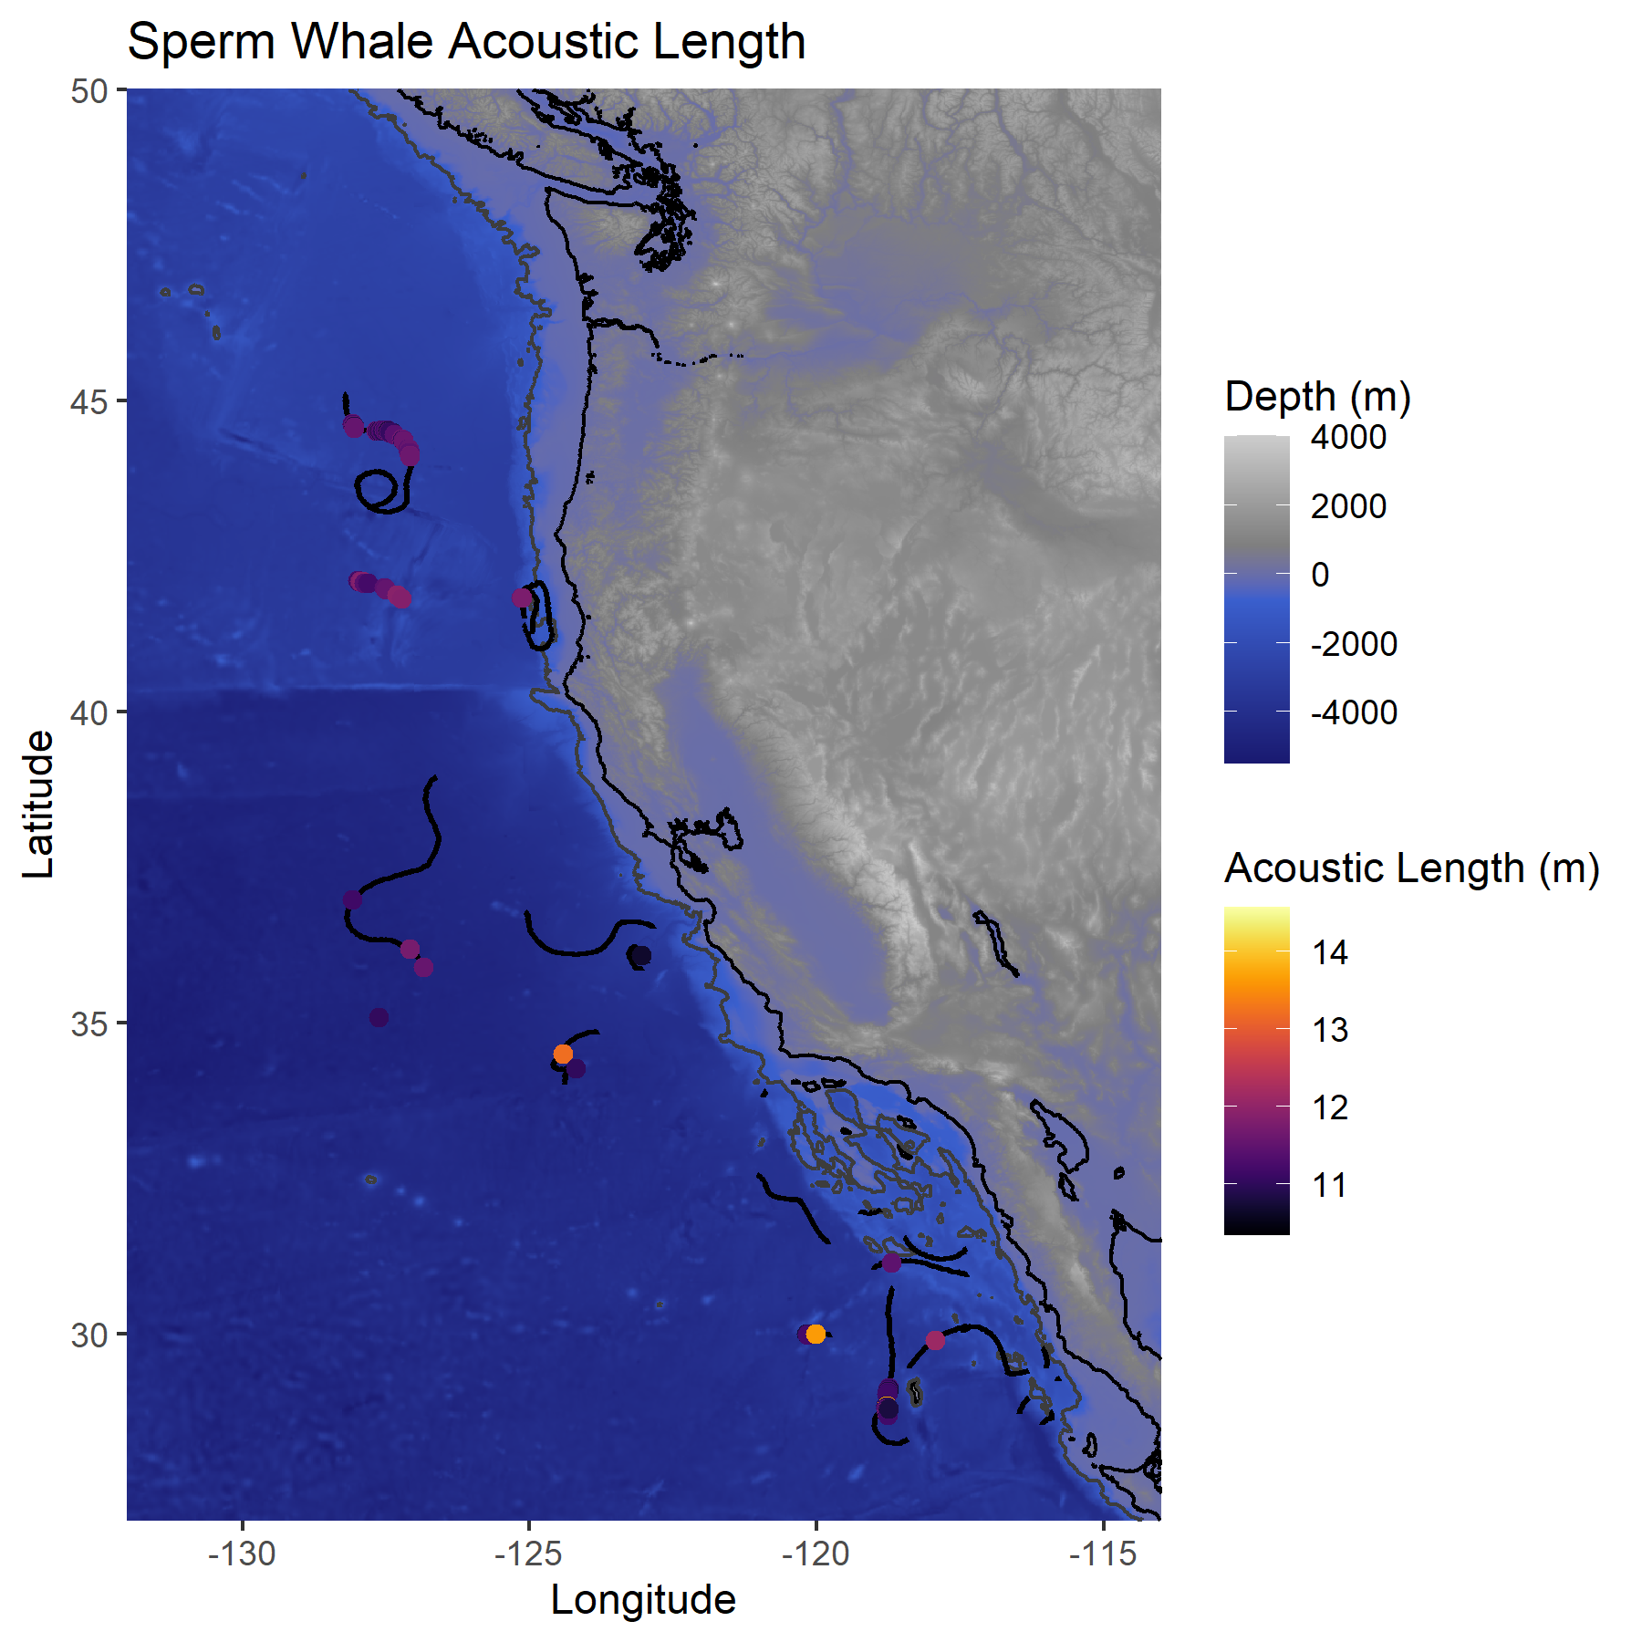
Study Site & Sperm Whale Detections
Females (11 - 12m) – Black, Purple
Males (12.5 – 14m) – Red, Orange, & Yellow
Notes:
1(MAP of Location of Study and Sperm Whale Detections): This MAP shows sperm whale detections along DASBRS in the California Current. The sperm whales of different lengths are pointed out by the dots on the map. The females represented by the black and purple dots were small and normally are 11-12 m long. They were spread out on the map from north to south in the California current. The males represented by the orange dots were large and normally are 12.5 – 14 m long. They were only detected a couple of times and when they were they were found in the southern region of the California current. Males and females are expected to be mixed in together in the California current (not polar region), but that wasn’t captured in this map because those characteristics would be found in complicated events only which was not included in this map.
We also see black lines of where the DASBRS were deployed represented by the triangles and where the DASBRS ended up represented by the squares. The female and male acoustic lengths were measured from their detections along the DASBRS.
It was concluded that the sperm whales were mostly found in the deepest depths of water (-4000). When they are found in these deep waters it is mainly when they are foraging to make echolocation clicks for us to analyze.
and are identified by the black and purple dots. Males are 12.5- 14 m long and are identified by the red, orange and yellow dots. separated throughout the map, which means it was gathered from simple acoustic events. The black lines represent the path of the DASBRS from where they were deployed and to where they ventured to. The acoustic length legends contains different colors that represent the acoustic length detections of female and male Sperm Whales measured in meters along the DASBRS. The depth legend contains the colors blue and grey that represents how deep the water was where the sperm whales were located. The sperm whales were mostly found in in the deepest depths of water (-4000) which is where they forage to make echolocation clicks for us to analyze.
AS: didn’t hear me say out loud or point on the map where the different sizes were and how they may be related to males and females. That is an important point that I still haven’t communicated. Spend a extra 30 seconds on this slide. Say: we know that females are going to be smaller than 12 m and the animals that are 12 m are smaller on this map are spread from the north to the south throughout the entire California current and there were only a couple of detections where we saw large males and they were mainly in the southern part of the current. We expect based on what we know of sperm whales that are males would prpabbly be mixed in with the females if they found them and we wouldn’t capture that in this map bc those are the complicated events that are not shown here.

Slide 13
Conclusion
Sperm whale lengths estimated with the sound of a couple of clicks.
The Inter-Click Interval allowed for easier calculations than the Inter-Pulse Interval.
Sperm Whale Detections of acoustic lengths were gathered from simple events.
Notes:
1(Bullet 1): We could estimate sperm whale lengths by just listening to a couple of clicks without any physical contact with the whales. This technique is really easy and very convenient.
2(Bullet 2): From the ICI to IPI relationship we found that the ICI was easier to calculate rather than the IPI. The ICI was used for most of the calculations in this study to get the best possible result for the body length.
3(Bullet 3): We were able to detect sperm whales with simple events easily, but for there to be accurate sperm whale detections with complicated events more work needs to be done.
The one thing you all should take from my presentation is that you can estimate the length of sperm whales based on their clicks!
The MAP of sperm whale detections were made of simple acoustic events which allowed us to gather the acoustic lengths. If they were complicated events, the lengths could not be gathered because multiple ICIs from each event would be detected. Thus, making it hard to find an accurate length from each whale.
SR: 1- (move to bullet 2) Present why easier is helpful early on then I can say yes its easier.
2 – (Move to bullet 1) we can estimate sperm whale length based on looking at just a couple of clicks. Its so much easier to do it this way.
3- We’re able to do this for simple events in the future we need to do a bit of a deeper dive to look at the complicated events. (make sure its clear that we could do it for simple events, but complicated events will need more work) (we did it and itll be easier this way but we still have work to do)
- We did it for simple events but we need more work for complicated events. (Analyzing the data from the ICI complicated events was a new task that needs to be further explored to receive accurate results.
)
Tell aud if you take one thing from my talk just know that you can estimate the length of sperm whales based on their clicks.

Slide 14
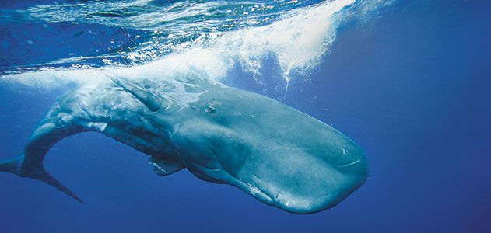
Acknowledgements
NOAA Mentors under the NMFS Office : Anne Simonis and Shannon Rankin
Funding Source: NOAA EPP/MSI Undergraduate Scholar Program
Any Questions?
brittany.melton@noaa.gov
Notes:
I would like to acknowledge the NOAA Marine Fisheries Service (NMFS) and my mentors who work under the NOAA Southwest fisheries office, Ms. Anne Simonis and Ms. Shannon Rankin. Lastly, I would like to thank the EPP/MSI Undergraduate Scholar Program for allowing me to be here & making this possible. Thank you for your time. I will now open the floor for questions.

